Slide 1
IT 1107 Mathematics for IT
Week 3 - Sets & set operations

Slide 2
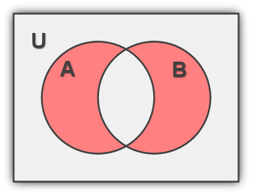
Symmetric Difference
The symmetric difference of the sets A & B consist of those elements which belong to A or B but not to both A & B
This is denoted by A ⊕ B
A ⊕ B = (A ∪ B )\ (A ∩ B)

Slide 3
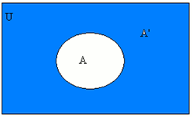
Compliment
The complement of set A is the set of elements which belongs to the universal set but which do not belongs to A
This is denoted by A^{c} /Ā /A’
Ā = { x: x ∉ A , x ∈ U }

Slide 4
Laws of algebra of sets
Idempotent laws
A ∩ A = A
A ∪ A = A
Assosiative laws
(A ∩ B) ∩ C = A ∩ (B ∩ C)
(A ∪ B) ∪ C = A ∪ (B ∪ C)
Commutative laws
A ∩ B = B ∩ A
A ∪ B = B ∪ A

Slide 5
Distributive laws
A ∩ (B ∪ C) = (A ∩ B) ∪ (A ∩ C)
A ∪ (B ∩ C) = (A ∪ B) ∩ (A ∪ C)
Identity laws
A ∪ ø = A
A ∩ U = A
A ∪ U = U
A ∩ ø = ø
Difference law
A-B = A ∩ B^{c}

Slide 6
Involution law
(A^{c})^{c} = A
Complement laws
A ∪ A' = U
A ∩ A' = ø
U ′ = ø
ø ′ = U
De morgan’s laws
(A ∩ B) ′ = A ′ ∪ B ′
(A ∪ B) ′ = A ′ ∩ B ′

Slide 7
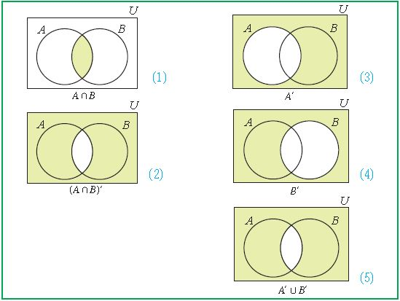
Proof of De Morgan’s law
Using Venn Diagram
(A ∩ B) ′ = A ′ ∪ B ′
LHS RHS

Slide 8
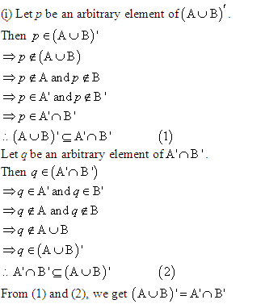
Algebraic method

Slide 9
Counting Principles
n (A ∪ B) = n(A) + n(B)
n (A ∪ B) = n(A) + n(B) - n (A ∩ B)
A
B
A
B

Slide 10
n (A ∪ B ∪ C) = n(A) + n(B) + n(C) - n (A ∩ B)
- n (A ∩ C) - n (C ∩ B) + n (A ∩ B ∩ C)
A
B
C

Slide 11
n(A/B) = n(A) -n (A ∩ B)
n (A^{c}) = n(U)-n(A)
A
B
A

Slide 12
Duality
If we interchange ∪ and ∩ and also U and ø in any statement about sets, then the new statement is called the dual of the original one.
For example, each of De Morgan's Laws is the dual of the other.
The first complement law, A ∪ A ′ = U, is the dual of the second: A ∩ A ′ = ø.

Slide 13
Inclusion Exclusion Principle
Inclusion Exclusion Principle determine the number of elements in a union of sets when some of the sets overlap
The Inclusion Exclusion Principle for Two or Three Sets
n(PUQ)=n(P) + n(Q) - n(P )
n(P U Q U R) = n(P) + n(Q) + n(R) - n(P∩ Q) - n(P ∩ R) - n(Q ∩ R) +n(P ∩ Q ∩ R)

